Slide 1
Machine Learning for data science and business intelligence – 8IAR403
By Kévin Bouchard Ph.D.
Professor in artificial intelligence & machine learning
Laboratoire d'Intelligence Ambiante pour la reconnaissance d'activités (LIARA)
Université du Québec à Chicoutimi
www.Kevin-Bouchard.ca

Slide 2



Summary of lesson #20
You will learn about:
A type of network adapted to data with temporal information
How to model various size of input and output
Special units called LSTM

Slide 3
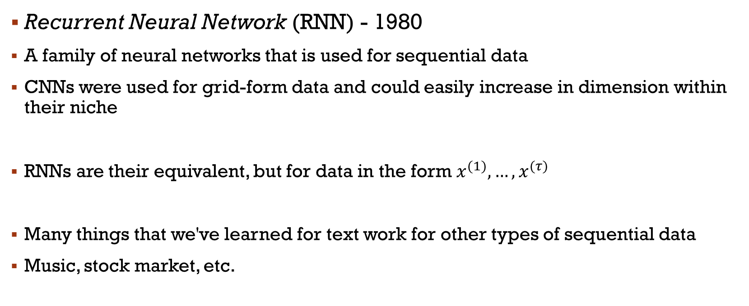
Recurrent Neural Network
Recurrent Neural Network (RNN) - 1980
A family of neural networks that is used for sequential data
CNNs were used for grid-form data and could easily increase in dimension within their niche
RNNs are their equivalent, but for data in the form $x^{(1)},…,x^{(τ)}$
Many things that we've learned for text work for other types of sequential data
Music, stock market, etc.
Notes:
Tau-temporel!!!
Dire communément, on parle de séries temporelles!

Slide 4
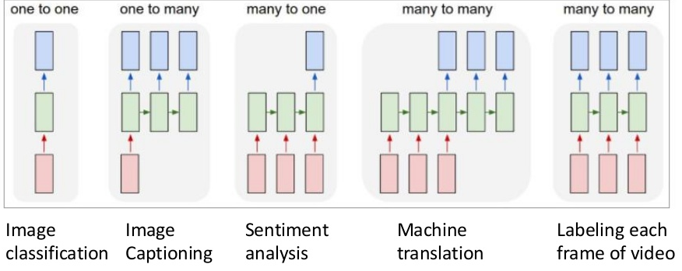
Recurrent Neural Network
They can actually support variable inputs and variable outputs!

Slide 5
Intuition
Sharing parameters across different parts of the model (as with CNNs)
If we were to use different parameters for each time value, we could not generalize to lengths not part of the training dataset
Moreover, we would not be able to reflect the importance of a subsequence across different positions in time
E.g.: 'I went to Iceland in 2017' and 'In 2017, I went to Iceland'
A feedforward network would have one weight per feature, with fixed-size sequences!!!
Learning each position to answer 'in what year?

Slide 6
Intuition
We could use1-D convolution
Weight sharing, but sparse
Few neighbors in the sequence, which limit the expressivity of the temporal informations captured
With RNNs, sharing is done differently
Each element of the output is a function of the previous members of the output
They are produced by applying the same update rule applied to the previous members
Thus, parameter sharing can be very deep

Slide 7
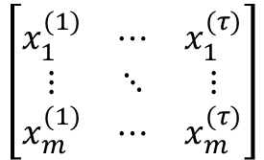
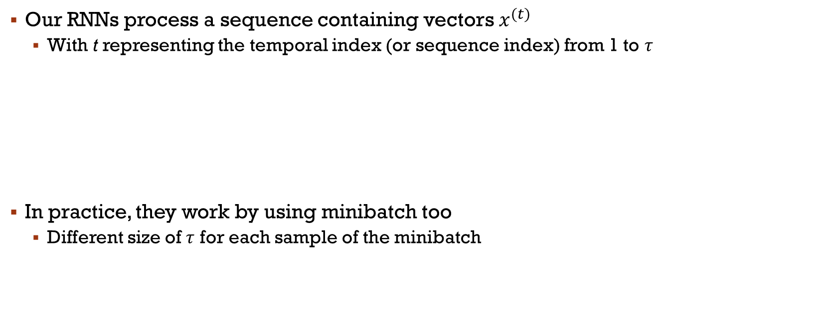
Intuition
Our RNNs process a sequence containing vectors $x^{(t)}$
With t representing the temporal index (or sequence index) from 1 to $τ$
In practice, they work by using minibatch too
Different size of $τ$ for each sample of the minibatch
$$\left[\begin{matrix}x_{1}^{(1)} & ⋯ & x_{1}^{(τ)} \\ ⋮ & ⋱ & ⋮ \\ x_{m}^{(1)} & ⋯ & x_{m}^{(τ)}\end{matrix}\right]$$

Slide 8
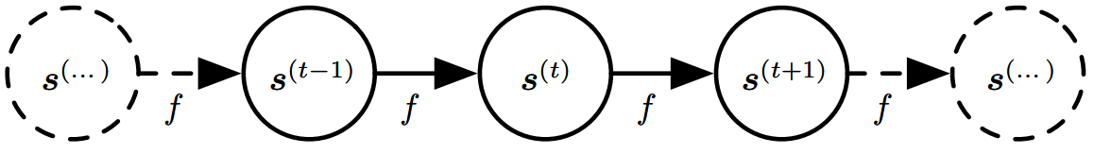
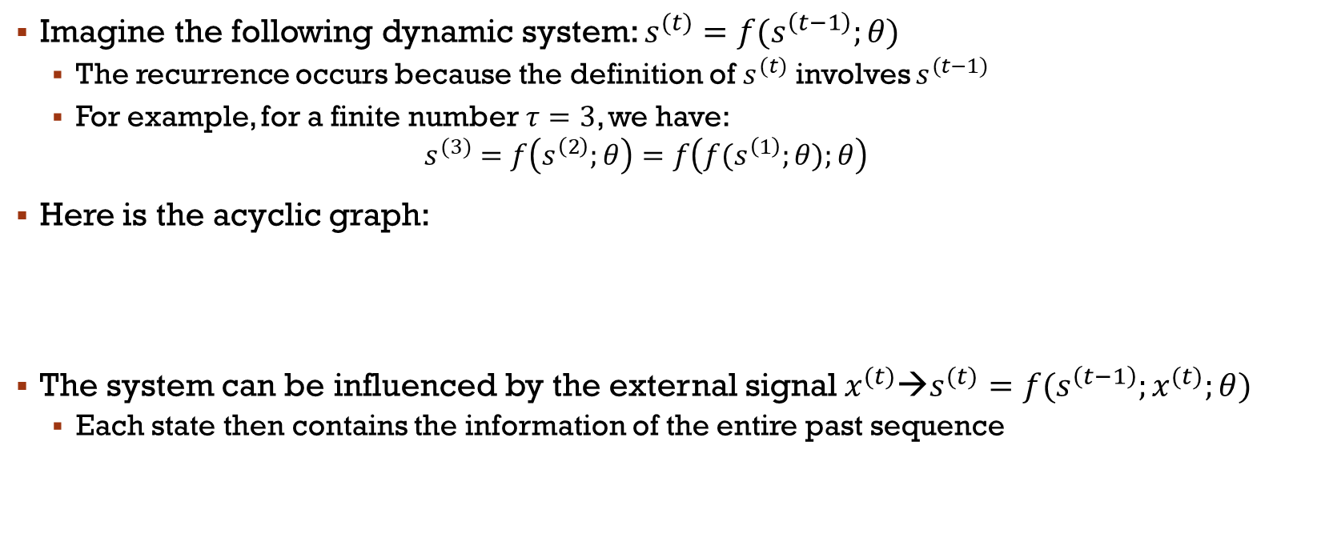
Recurrence
Imagine the following dynamic system: $s^{(t)}=f(s^{\left(t−1\right)};θ)$
The recurrence occurs because the definition of $s^{(t)}$ involves $s^{(t−1)}$
For example, for a finite number$τ=3$, we have:
$$s^{(3)}=f\left(s^{\left(2\right)};θ\right)=f\left({f(s}^{\left(1\right)};θ);θ\right)$$
Here is the acyclic graph:
The system can be influenced by the external signal$x^{(t)}$→$s^{(t)}=f(s^{\left(t−1\right)};x^{(t)};θ)$
Each state then contains the information of the entire past sequence
Notes:
Theta – hyper paramètre

Slide 9
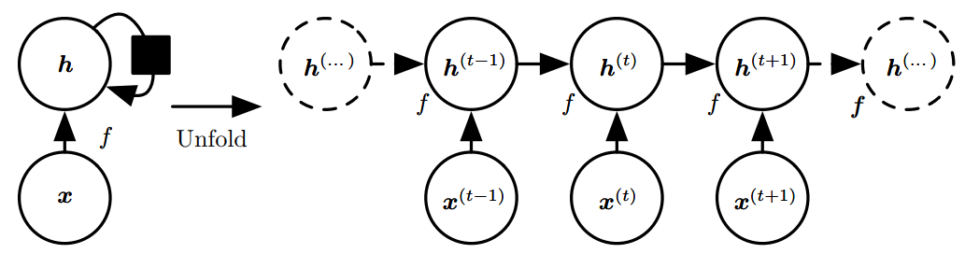
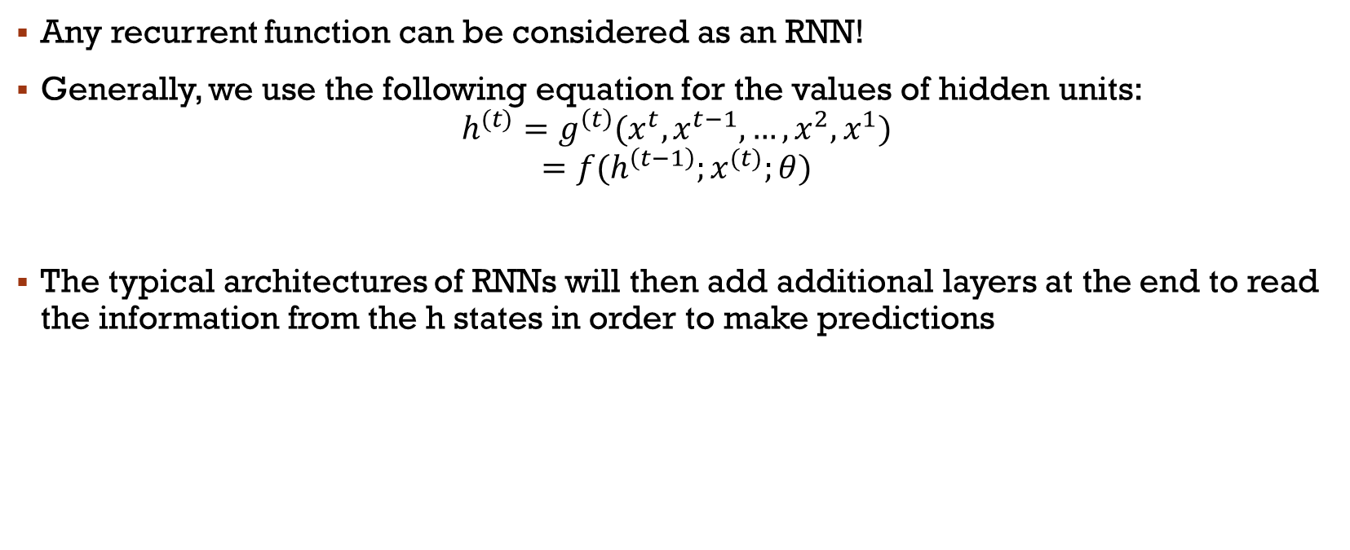
Recurrence
Any recurrent function can be considered as an RNN!
Generally, we use the following equation for the values of hidden units:
$$h^{(t)}=g^{\left(t\right)}(x^{t}, x^{t−1}, …,x^{2}, x^{1})$$
$$=f(h^{\left(t−1\right)};x^{(t)};θ)$$
The typical architectures of RNNs will then add additional layers at the end to read the information from the h states in order to make predictions
Notes:
Pas d’output. Carré=une unité de temps

Slide 10
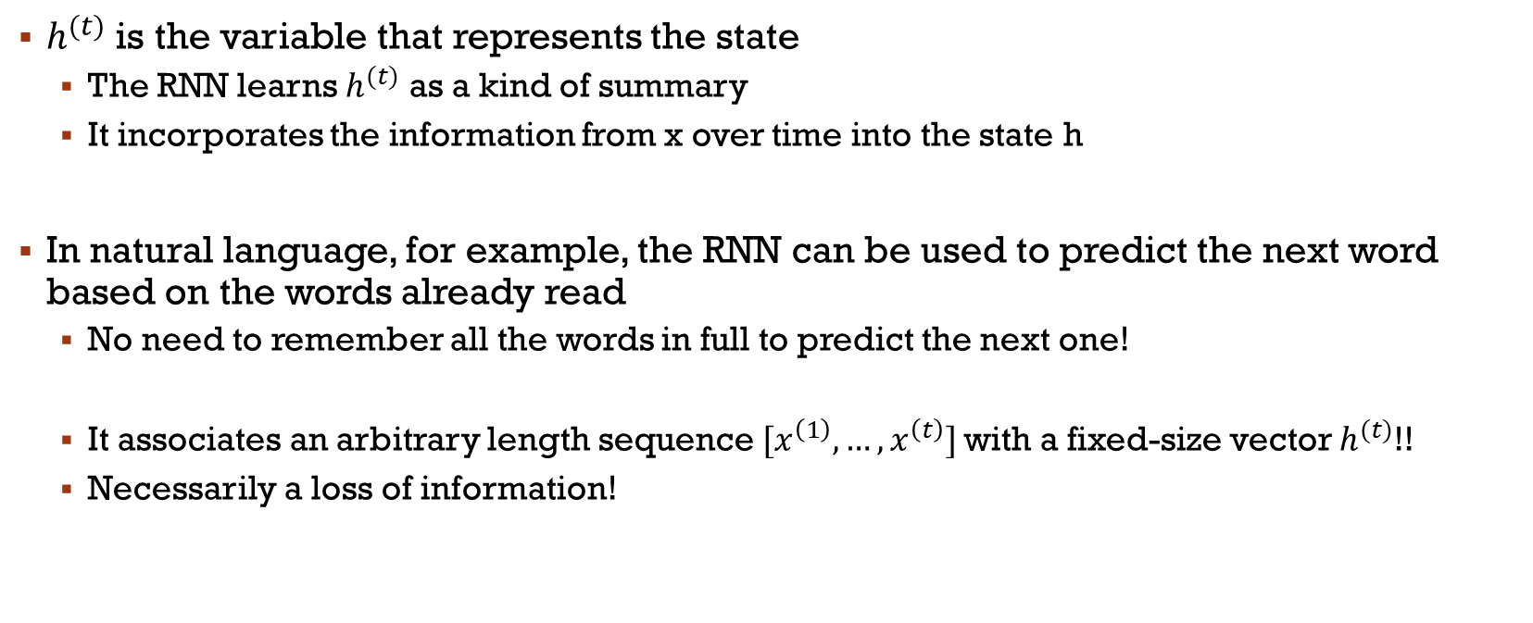
Recurrence
$h^{(t)}$ is the variable that represents the state
The RNN learns $h^{(t)}$ as a kind of summary
It incorporates the information from x over time into the state h
In natural language, for example, the RNN can be used to predict the next word based on the words already read
No need to remember all the words in full to predict the next one!
It associates an arbitrary length sequence$[x^{\left(1\right)}, …, x^{\left(t\right)}]$ with a fixed-size vector $h^{(t)}$!!
Necessarily a loss of information!

Slide 11

Recurrence
The unfolding of an RNN has two major advantages
No matter the length of the sequence, the learned model always has the same input size
Specified in terms of transitions from one state to another
Rather than in terms of a history of states (variable size)
It is possible to use the same transition function f() with the same parameters at each step
No need to learn a model g() for all possible step stages!!!
A single model f()→better generalization!!!"

Slide 12
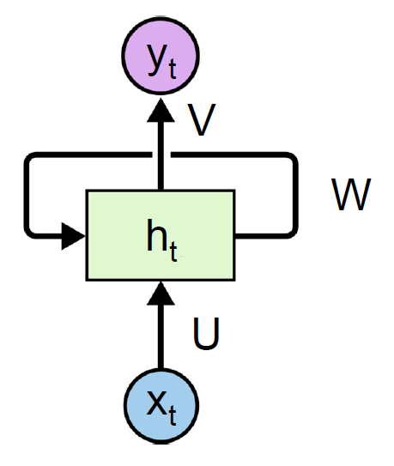
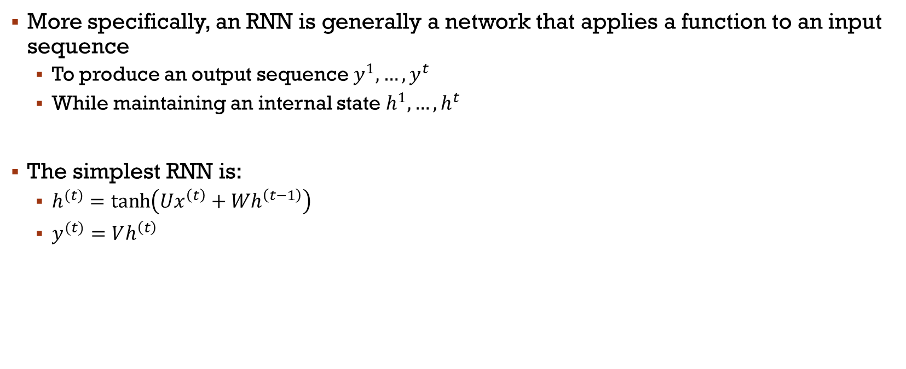
RNN
More specifically, an RNN is generally a network that applies a function to an input sequence
To produce an output sequence $y^{1},…,y^{t}$
While maintaining an internal state$h^{1},…,h^{t}$
The simplest RNN is:
$h^{(t)}=\tanh\left(Ux^{\left(t\right)}+{Wh}^{\left(t−1\right)}\right)$
$y^{(t)}=Vh^{\left(t\right)}$
Prediction every
time step
Activation

Slide 13
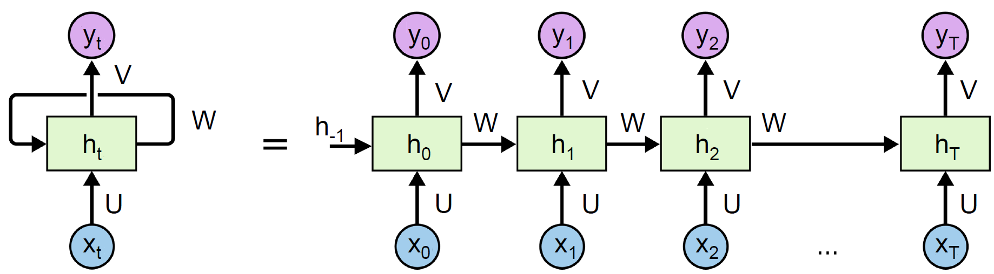
RNN - Unfolding over time
The parameters are propagated over time (or through the sequence)
U is the weight matrix between the inputs and the hidden layer
W is the weight matrix between the units of the hidden layer
V is the weight matrix between the hidden units and the output layer
Notes:
Dire qu’un RNN est plusieurs unités en parallèle (e.g. 128)

Slide 14
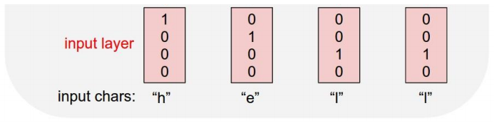
ExAmple
Character Prediction
Vocabulary: [h, e, l, o]
Example of training: 'hello'

Slide 15
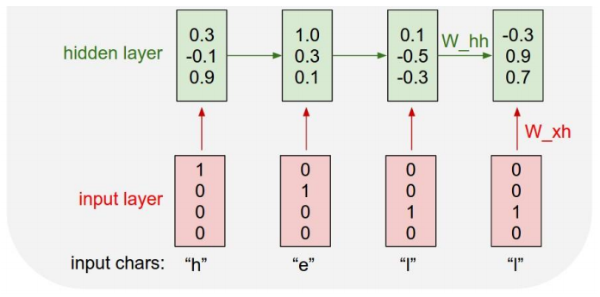
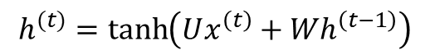
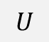

Example
$$h^{(t)}=\tanh\left(Ux^{\left(t\right)}+{Wh}^{\left(t−1\right)}\right)$$
Character Prediction
Vocabulary: [h, e, l, o]
Example of training: 'hello'
$$W$$
Fct d’activation
$$U$$
Notes:
3 neurons cachés (U est 4x3), (W est 3x3)

Slide 16
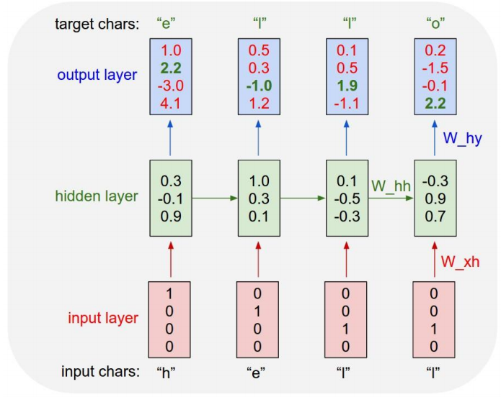
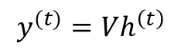
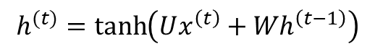


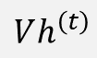
Example
$$h^{(t)}=\tanh\left(Ux^{\left(t\right)}+{Wh}^{\left(t−1\right)}\right)$$
$$y^{(t)}=Vh^{\left(t\right)}$$
Character Prediction
Vocabulary: [h, e, l, o]
Example of training: 'hello'
$$Vh^{\left(t\right)}$$
$$W$$
Activation
$$U$$
Notes:
Améliorer les chiffres verts (gradients)->V est 3x4
Loss function!!!

Slide 17
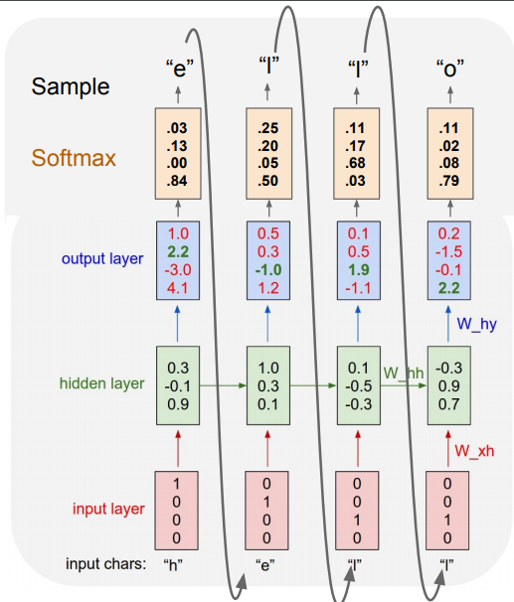


Example
We can add a Softmax (prob=1)
Not for training
$$Vh^{\left(t\right)}$$
$$W$$
$$U$$
Notes:
Probabilités normalisés!

Slide 18
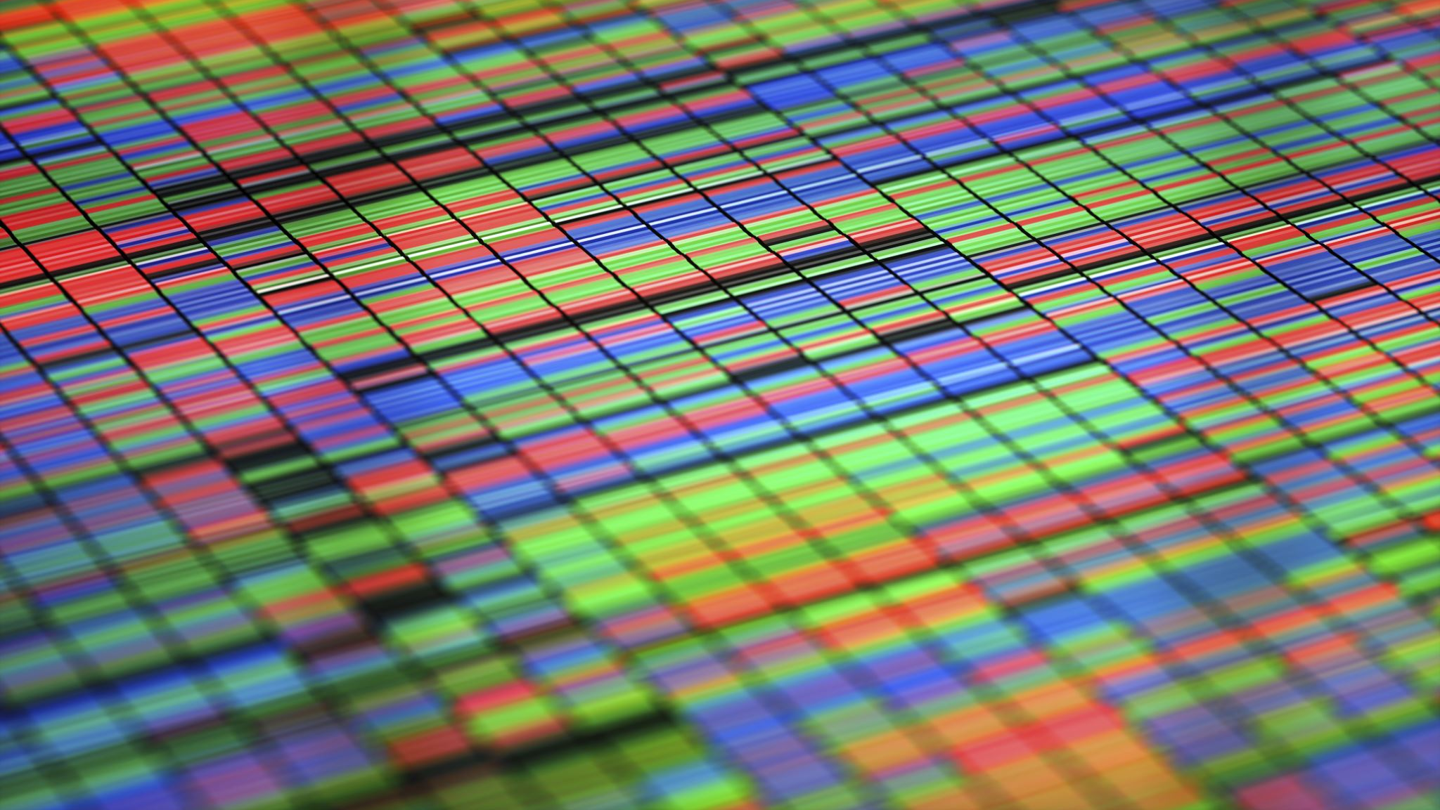


RNN Applications

Slide 19
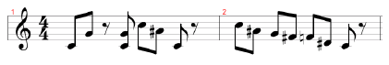
Music recognition
Task: Recognizing the musical genre from music scores.
Training Data: There are 500 music scores with varying durations.
Input (x): Music scores.
Output Classes: There are three classes: Blues, Rock, and Classical.
Corresponding Labels (c):
Blues: (1, 0, 0)
Rock: (0, 1, 0)
Classical: (0, 0, 1)

Slide 20
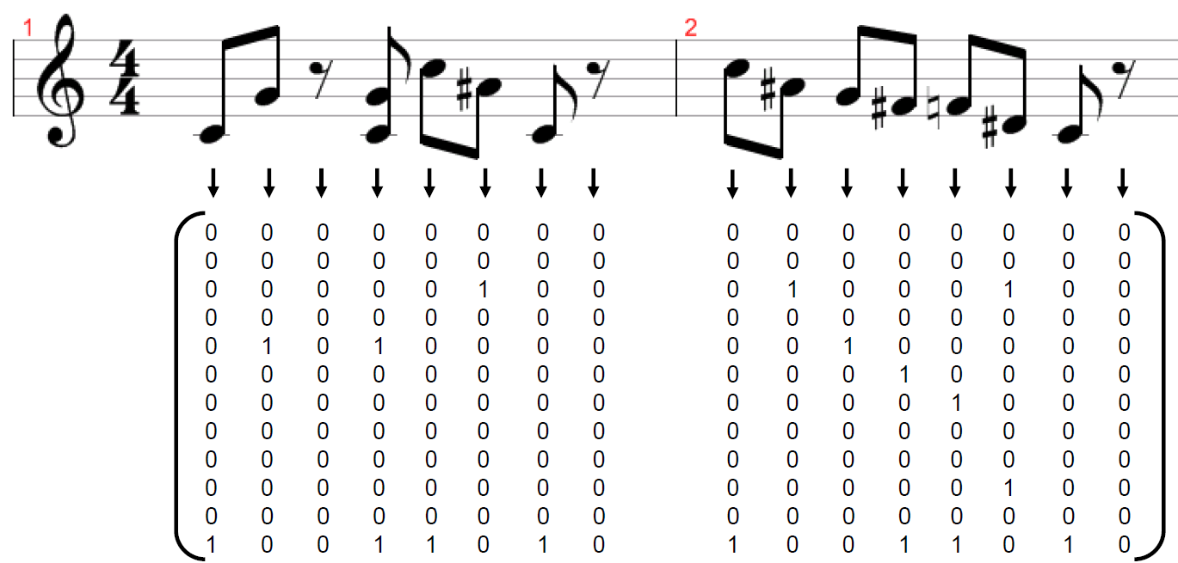
Representation

Slide 21
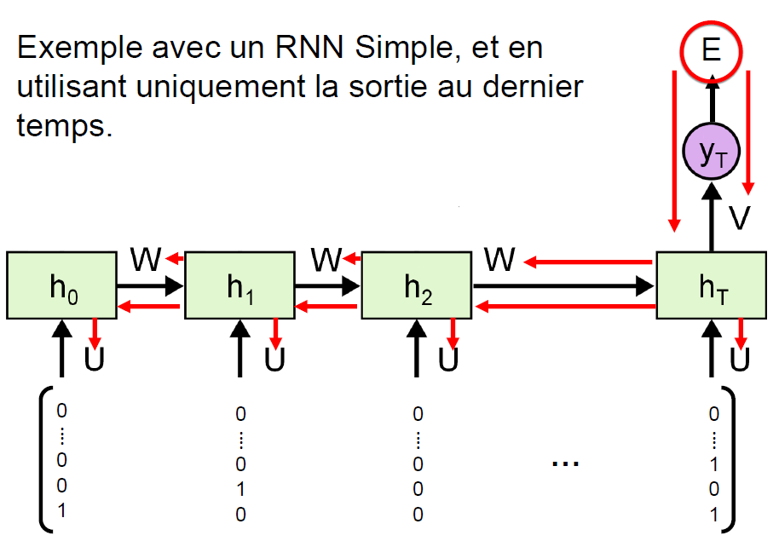
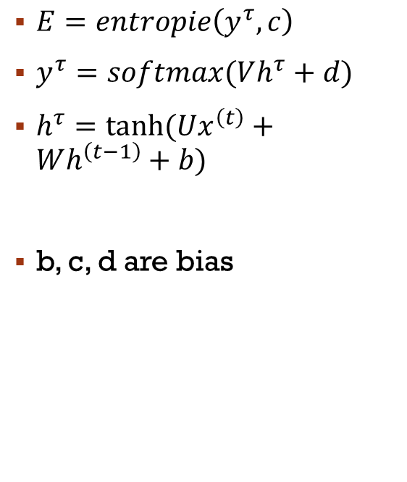
Model
$E=entropie\left(y^{τ},c\right)$
$y^{τ}=softmax(Vh^{τ}+d)$
$h^{τ}=tanh⁡(Ux^{\left(t\right)}+Wh^{\left(t−1\right)}+b)$
b, c, d are bias
Notes:
Tau est variable!!!!!!

Slide 22
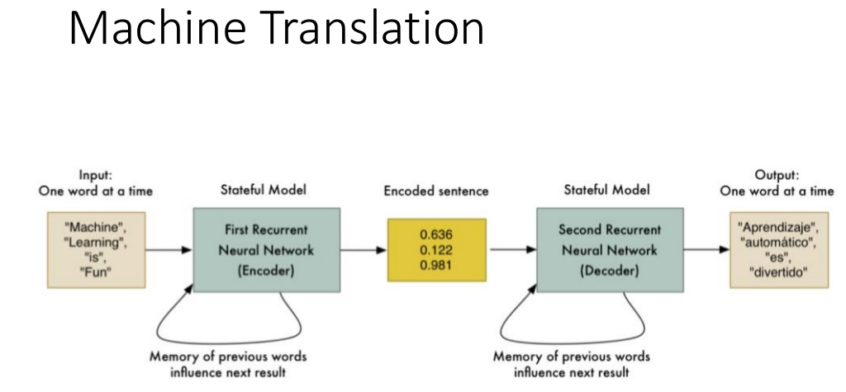
Examples

Slide 23
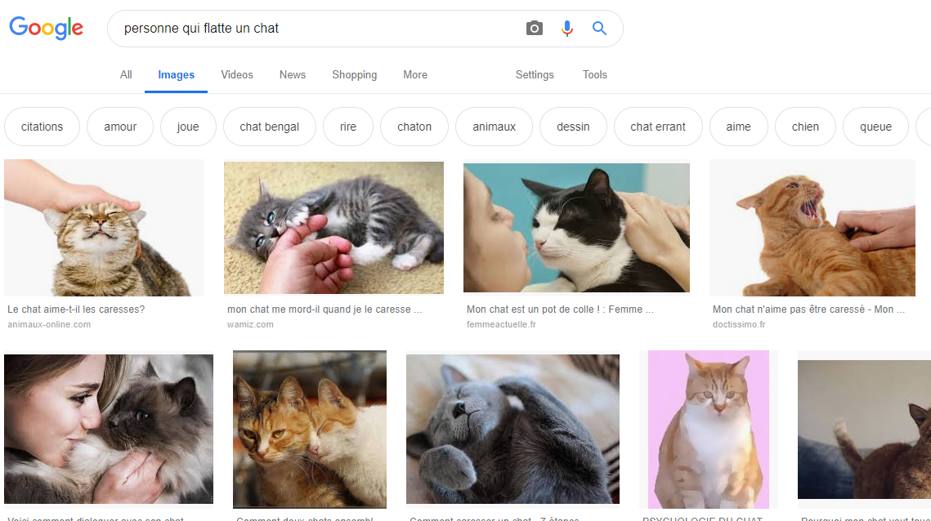
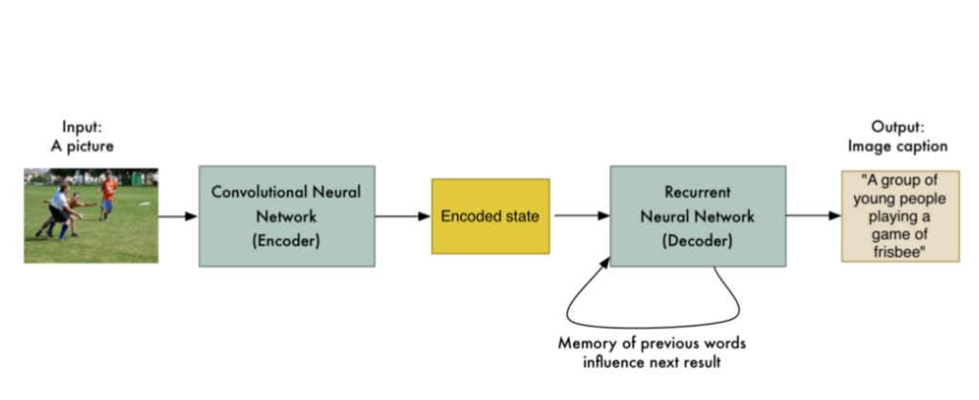
Examples

Slide 24
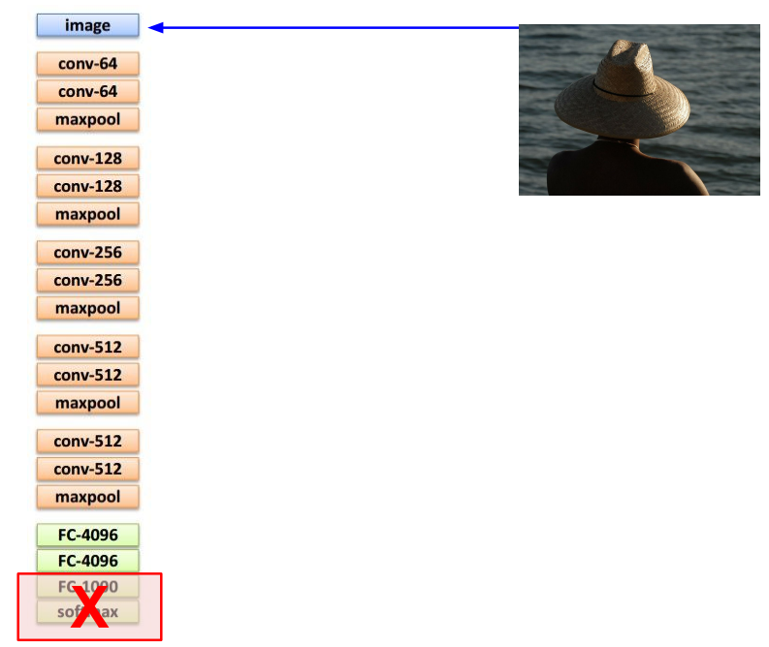
Examples

Slide 25
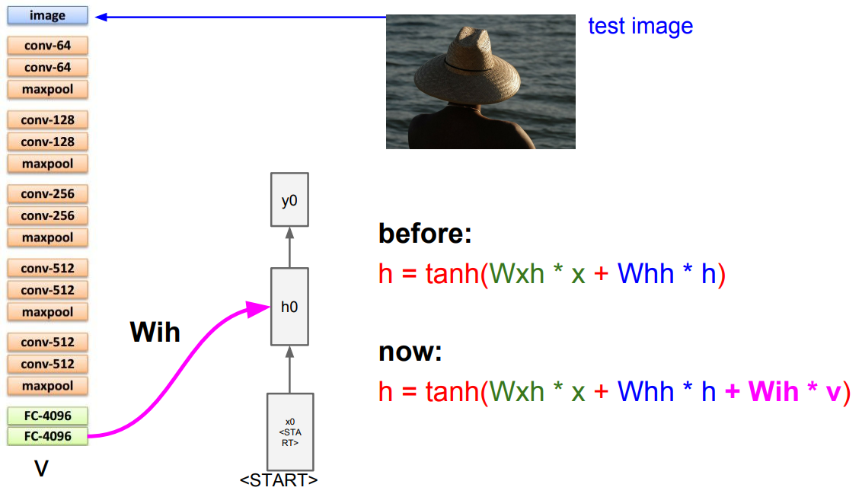

Exemples
Before:
$$h^{(t)}=\tanh\left(Ux^{\left(t\right)}+{Wh}^{\left(t−1\right)}\right)$$
Q
Now:
$$h^{(t)}=\tanh\left(Ux^{\left(t\right)}+{Wh}^{\left(t−1\right)}+Qv\right)$$

Slide 26
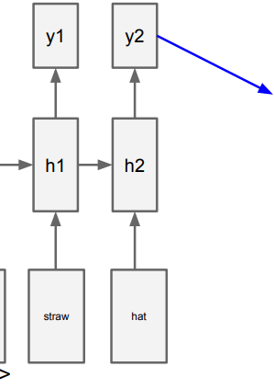
Examples
Prediction is the token <END>
→We can end the subtitling!
Q

Slide 27
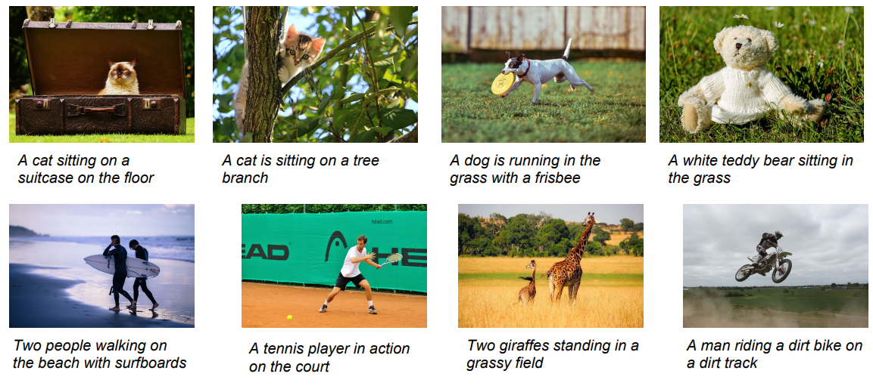
Examples
Some good results:

Slide 28
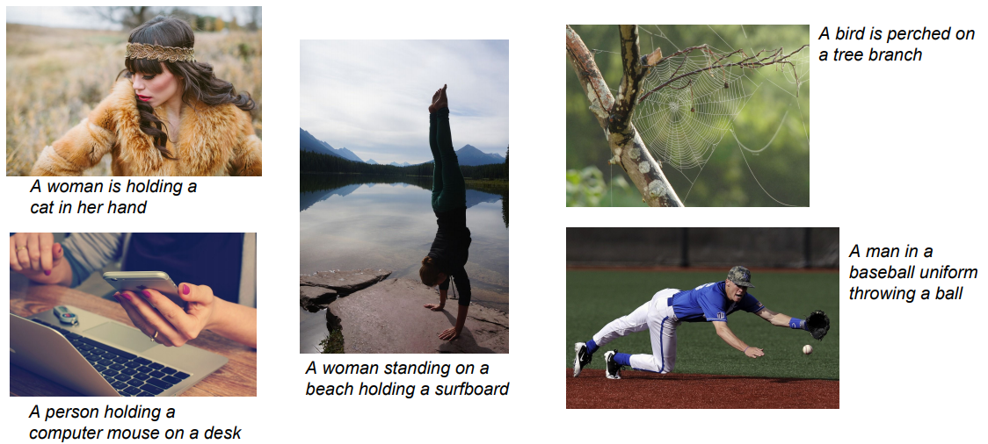
Examples
Some not so good…

Slide 29
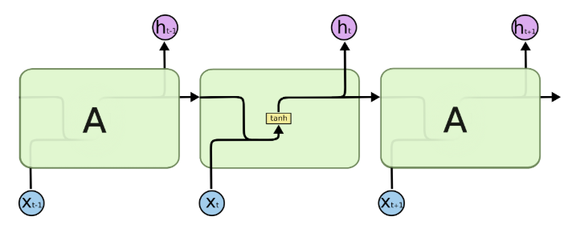
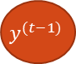
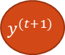
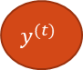
Special Architecture
The module in a standard RNN contains a single layer
$$y^{(t−1)}$$
$$y^{(t)}$$
$$y^{(t+1)}$$

Slide 30
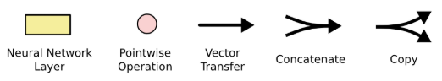
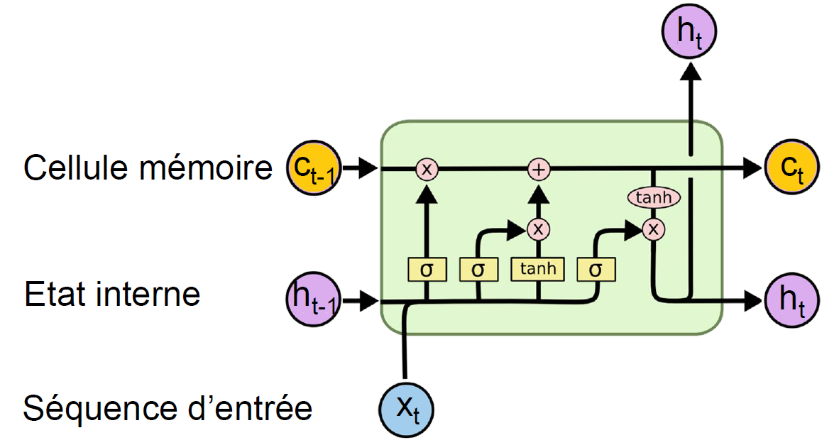
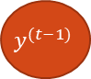
Long Short-Term Memory (LSTM)
$$y^{(t−1)}$$
Introduce a gate mechanism
To get a finer control on what is remembered…
… and forgotten
Add a memory cell
Memory cell
Internal state
Input sequence
Output gate
Input gate
Forget gate
Notes:
Pointwise—point à point

Slide 31

Long Short-Term Memory (LSTM)
The memory cell is the key to LSTMs
It's like a conveyor belt that rolls over the entire sequence with simple interactions
Information is added or removed based on the gates

Slide 32
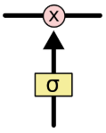

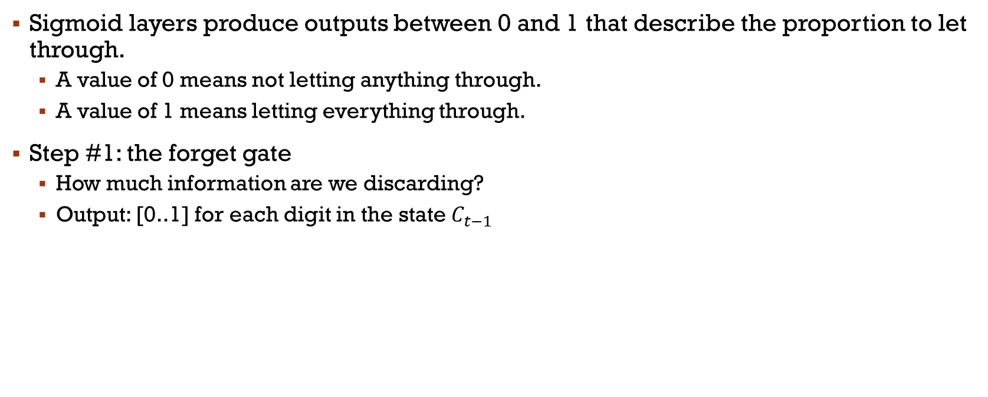
Long Short-Term Memory (LSTM)
Sigmoid layers produce outputs between 0 and 1 that describe the proportion to let through.
A value of 0 means not letting anything through.
A value of 1 means letting everything through.
Step #1: the forget gate
How much information are we discarding?
Output: [0..1] for each digit in the state$C_{t−1}$

Slide 33

Long Short-Term Memory (LSTM)
Step #2: New Inputs
Which values will be updated? (input gate → sigmoid), where b is a bias.
How much of the new information will we keep?
Tanh → Potential values
Combination = Update of the state

Slide 34


Long Short-Term Memory (LSTM)
Step #3: update of $C_{t−1}$

Slide 35


Long Short-Term Memory (LSTM)
Step #4: Evaluation of the output $y_{t}$ (in the image, it is $h_{t}$)
Based on the state of the cell, but filtered
The part we had in the basic RNN $∗tanh⁡(C_{t})$
Notes:
Ot est le ht…
Tanh [-1..1]

Slide 36
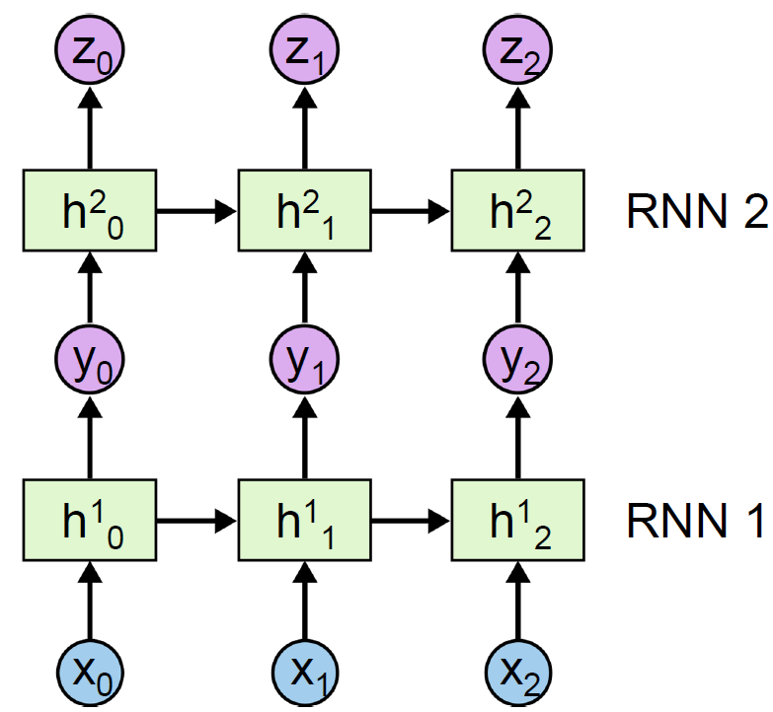
Deep RNN?
To create deep RNNs, you can simply stack layers
Each RNN layer can be an RNN, LSTM, or another recurrent model
The output sequence of one layer becomes the input sequence of the next layer

Slide 37
Main References
Russell S., Norvig P., Artificial Intelligence: A Modern Approach. Prentice-Hall, Englewood Cliffs, 2021.
Aggarwal, C. C., Neural networks and deep learning. Springer, 2023.
Goodfellow I., Bengio Y., Deep Learning. The MIT Press, 2016.
Raschka S., Python Machine Learning, Packt Publishing, 2015.
Sutton R.S., Barto A.G., Reinforcement Learning: An Introduction, A Bradford Book, 2021.
Witten I.H., Frank E., Hall M.A., Pal C. Data Mining: Practical Machine Learning Tools and Techniques, Morgan Kaufmann, 2016.

